Slide 1


DEPARTEMEN SISTEM INFORMASI
Fak. Teknologi Elektro & Informatika Cerdas
IW184301
DATABASE SYSTEMS
Chapter 04-1
Entity Relationship Modeling
Prof. Ir. Arif Djunaidy, M.Sc., Ph.D.
adjunaidy@is.its.ac.id
adjunaidy@gmail.com

Slide 2
Learning Objectives & Book Reading
Learning Objectives - To Understand:
the role of high-level conceptual data models in database design
the use of concepts from the ER model
the concepts of entities and attributes, and the diagrammatic technique for displaying an ER schema
The concepts of binary relationships and their roles and structural constraints
The concept of weak entity types
how a schema design is refined to include relationships
the concept of complex types of relationships
Book reading:
Elmasri, Chapter 7
ER Modeling
Chapter 04-1 / 2

Slide 3
Outline
Overview of Database Design Process
Example Database Application (COMPANY)
ER Model Concepts
Entities and Attributes
Entity Types, Value Sets, and Key Attributes
Relationships and Relationship Types
Weak Entity Types
Roles and Attributes in Relationship Types
ER Diagrams - Notation
Example: ER Diagram for COMPANY Schema
ER Modeling
Chapter 04 / 3

Slide 4
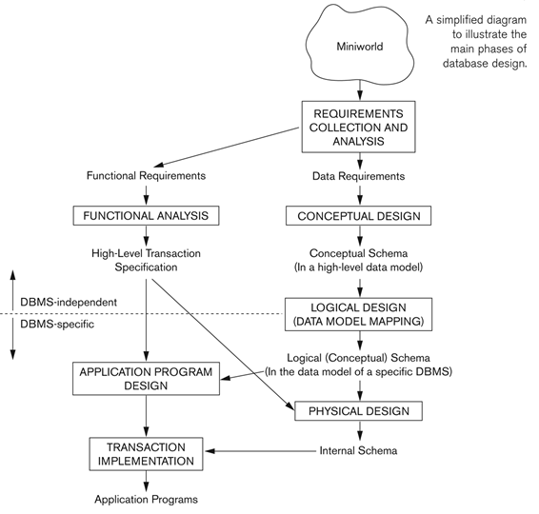
Overview of Database Design Process
ER Modeling
Chapter 04-1 / 4

Slide 5
Example COMPANY Database
We need to create a database schema design based on the following (simplified) requirements of the COMPANY Database:
The company is organized into DEPARTMENTs. Each department has a name, number and an employee who manages the department. We keep track of the start date of the department manager. A department may have several locations.
Each department controls a number of PROJECTs. Each project has a unique name, unique number and is located at a single location.
ER Modeling
Chapter 04-1 / 5

Slide 6
Example COMPANY Database (Contd.)
We store each EMPLOYEE’s social security number, address, salary, sex, and birthdate.
Each employee works for one department but may work on several projects.
We keep track of the number of hours per week that an employee currently works on each project.
We also keep track of the direct supervisor of each employee.
Each employee may have a number of DEPENDENTs.
For each dependent, we keep track of their name, sex, birthdate, and relationship to the employee.
ER Modeling
Chapter 04-1 / 6

Slide 7
ER Model Concepts
Entities and Attributes
Entities are specific objects or things in the mini-world that are represented in the database.
For example the EMPLOYEE John Smith, the Research DEPARTMENT, the ProductX PROJECT
Attributes are properties used to describe an entity.
For example an EMPLOYEE entity may have the attributes Name, SSN, Address, Sex, BirthDate
A specific entity will have a value for each of its attributes.
For example a specific employee entity may have Name='John Smith', SSN='123456789', Address ='731, Fondren, Houston, TX', Sex='M', BirthDate='09-JAN-55‘
Each attribute has a value set (or data type) associated with it – e.g. integer, string, subrange, enumerated type, …
ER Modeling
Chapter 04-1 / 7

Slide 8
Types of Attributes (1)
Simple
Each entity has a single atomic value for the attribute. For example, SSN or Sex.
Composite
The attribute may be composed of several components. For example:
Address(Apt#, House#, Street, City, State, ZipCode, Country), or
Name(FirstName, MiddleName, LastName).
Composition may form a hierarchy where some components are themselves composite.
Multi-valued
An entity may have multiple values for that attribute. For example, Color of a CAR or PreviousDegrees of a STUDENT.
Denoted as {Color} or {PreviousDegrees}.
ER Modeling
Chapter 04-1 / 8

Slide 9
Types of Attributes (2)
In general, composite and multi-valued attributes may be nested arbitrarily to any number of levels, although this is rare.
For example, PreviousDegrees of a STUDENT is a composite multi-valued attribute denoted by {PreviousDegrees (College, Year, Degree, Field)}
Multiple PreviousDegrees values can exist
Each has four subcomponent attributes:
College, Year, Degree, Field
ER Modeling
Chapter 04-1 / 9

Slide 10
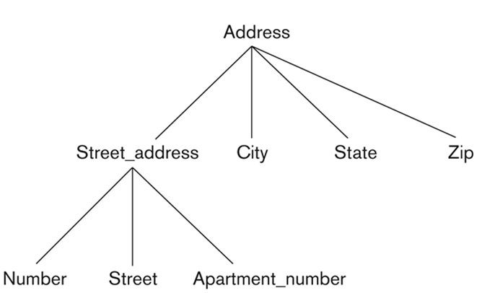
Hierarchy of Composite Attribute
ER Modeling
Chapter 04-1 / 10

Slide 11
Entity Types and Key Attributes (1)
Entities with the same basic attributes are grouped or typed into an entity type.
For example, the entity type EMPLOYEE and PROJECT.
An attribute of an entity type for which each entity must have a unique value is called a key attribute of the entity type.
For example, SSN of EMPLOYEE.
ER Modeling
Chapter 04-1 / 11

Slide 12
Entity Types and Key Attributes (2)
A key attribute may be composite.
VehicleTagNumber is a key of the CAR entity type with components (Number, State).
An entity type may have more than one key.
The CAR entity type may have two keys:
VehicleIdentificationNumber (popularly called VIN)
VehicleTagNumber (Number, State), aka license plate number.
Each key is underlined
ER Modeling
Chapter 04-1 / 12

Slide 13
Displaying an Entity type
In ER diagrams, an entity type is displayed in a rectangular box
Attributes are displayed in ovals
Each attribute is connected to its entity type
Components of a composite attribute are connected to the oval representing the composite attribute
Each key attribute is underlined
Multivalued attributes displayed in double ovals
See CAR example on next slide
ER Modeling
Chapter 04-1 / 13

Slide 14
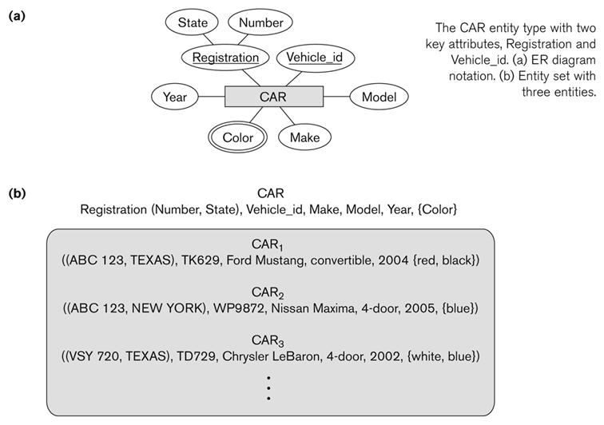
Entity Type CAR with two keys and a corresponding Entity Set
ER Modeling
Chapter 04-1 / 14

Slide 15
Entity Set
Each entity type will have a collection of entities stored in the database
Called the entity set
Previous slide shows three CAR entity instances in the entity set for CAR
Same name (CAR) used to refer to both the entity type and the entity set
Entity set is the current state of the entities of that type that are stored in the database
ER Modeling
Chapter 04-1 / 15

Slide 16
Initial Design of Entity Types for the COMPANY Database Schema
Based on the requirements, we can identify four initial entity types in the COMPANY database:
DEPARTMENT
PROJECT
EMPLOYEE
DEPENDENT
Their initial design is shown on the following slide
The initial attributes shown are derived from the requirements description
ER Modeling
Chapter 04-1 / 16

Slide 17
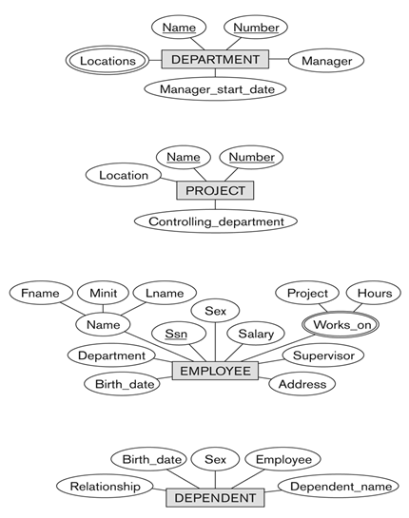
Initial Design of Entity Types: EMPLOYEE, DEPARTMENT, PROJECT, DEPENDENT
ER Modeling
Chapter 04-1 / 17

Slide 18
Refining the initial design by introducing relationships
The initial design is typically not complete
Some aspects in the requirements will be represented as relationships
ER model has three main concepts:
Entities (and their entity types and entity sets)
Attributes (simple, composite, multivalued)
Relationships (and their relationship types and relationship sets)
We introduce relationship concepts next
ER Modeling
Chapter 04-1 / 18

Slide 19
Relationships and Relationship Types (1)
A relationship relates two or more distinct entities with a specific meaning.
For example, EMPLOYEE John Smith works on the ProductX PROJECT, or EMPLOYEE Franklin Wong manages the Research DEPARTMENT.
Relationships of the same type are grouped or typed into a relationship type.
For example, the WORKS_ON relationship type in which EMPLOYEEs and PROJECTs participate, or the MANAGES relationship type in which EMPLOYEEs and DEPARTMENTs participate.
The degree of a relationship type is the number of participating entity types.
Both MANAGES and WORKS_ON are binary relationships.
ER Modeling
Chapter 04-1 / 19

Slide 20
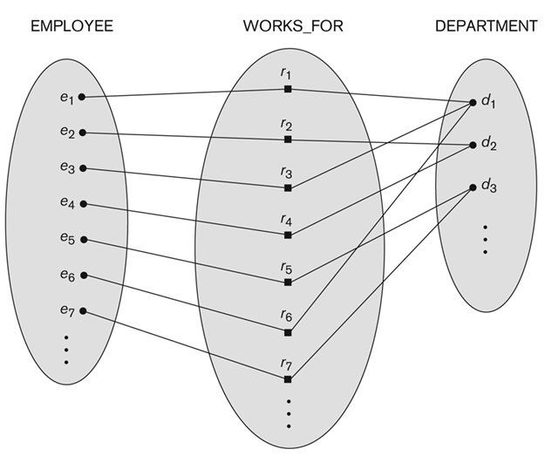
Relationship instances of the WORKS_FOR N:1 relationship between EMPLOYEE and DEPARTMENT
ER Modeling
Chapter 04-1 / 20

Slide 21
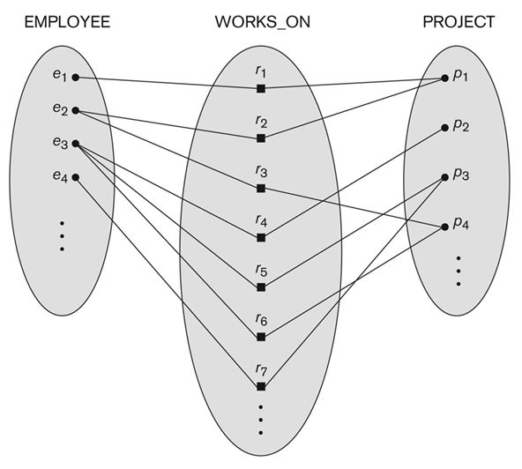
Relationship instances of the M:N WORKS_ON relationship between EMPLOYEE and PROJECT
ER Modeling
Chapter 04-1 / 21

Slide 22
Relationship type vs. relationship set (1)
Relationship Type:
Is the schema description of a relationship
Identifies the relationship name and the participating entity types
Also identifies certain relationship constraints
Relationship Set:
The current set of relationship instances represented in the database
The current state of a relationship type
ER Modeling
Chapter 04-1 / 22

Slide 23
Relationship type vs. relationship set (2)
Previous figures displayed the relationship sets
Each instance in the set relates individual participating entities – one from each participating entity type
In ER diagrams, we represent the relationship type as follows:
Diamond-shaped box is used to display a relationship type
Connected to the participating entity types via straight lines
ER Modeling
Chapter 04-1 / 23

Slide 24
Refining the COMPANY database schema by introducing relationships
By examining the requirements, six relationship types are identified
All are binary relationships( degree 2)
Listed below with their participating entity types:
WORKS_FOR (between EMPLOYEE, DEPARTMENT)
MANAGES (also between EMPLOYEE, DEPARTMENT)
CONTROLS (between DEPARTMENT, PROJECT)
WORKS_ON (between EMPLOYEE, PROJECT)
SUPERVISION (between EMPLOYEE (as subordinate), EMPLOYEE (as supervisor))
DEPENDENTS_OF (between EMPLOYEE, DEPENDENT)
ER Modeling
Chapter 04-1 / 24

Slide 25
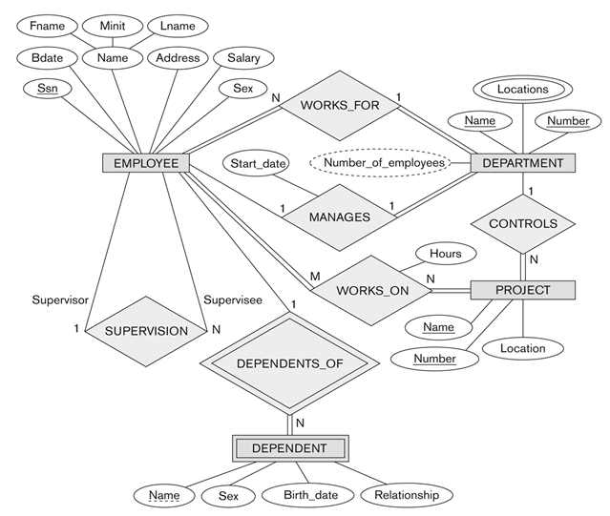
ER DIAGRAM – Relationship Types are: WORKS_FOR, MANAGES, WORKS_ON, CONTROLS, SUPERVISION, DEPENDENTS_OF
ER Modeling
Chapter 04-1 / 25

Slide 26
Discussion on Relationship Types
In the refined design, some attributes from the initial entity types are refined into relationships:
Manager of DEPARTMENT -> MANAGES
Works_on of EMPLOYEE -> WORKS_ON
Department of EMPLOYEE -> WORKS_FOR
etc
In general, more than one relationship type can exist between the same participating entity types
MANAGES and WORKS_FOR are distinct relationship types between EMPLOYEE and DEPARTMENT
Different meanings and different relationship instances.
ER Modeling
Chapter 04-1 / 26

Slide 27
Recursive Relationship Type
An relationship type whose with the same participating entity type in distinct roles
Example: the SUPERVISION relationship
EMPLOYEE participates twice in two distinct roles:
supervisor (or boss) role
supervisee (or subordinate) role
Each relationship instance relates two distinct EMPLOYEE entities:
One employee in supervisor role
One employee in supervisee role
ER Modeling
Chapter 04-1 / 27

Slide 28
Weak Entity Types
An entity that does not have a key attribute
A weak entity must participate in an identifying relationship type with an owner or identifying entity type
Entities are identified by the combination of:
A partial key of the weak entity type
The particular entity they are related to in the identifying entity type
Example:
A DEPENDENT entity is identified by the dependent’s first name, and the specific EMPLOYEE with whom the dependent is related
Name of DEPENDENT is the partial key
DEPENDENT is a weak entity type
EMPLOYEE is its identifying entity type via the identifying relationship type DEPENDENT_OF
ER Modeling
Chapter 04-1 / 28

Slide 29
Constraints on Relationships
Constraints on Relationship Types
(Also known as ratio constraints)
Cardinality Ratio (specifies maximum participation)
One-to-one (1:1)
One-to-many (1:N) or Many-to-one (N:1)
Many-to-many (M:N)
Existence Dependency Constraint (specifies minimum participation) (also called participation constraint)
zero (optional participation, not existence-dependent)
one or more (mandatory participation, existence-dependent)
ER Modeling
Chapter 04-1 / 29

Slide 30
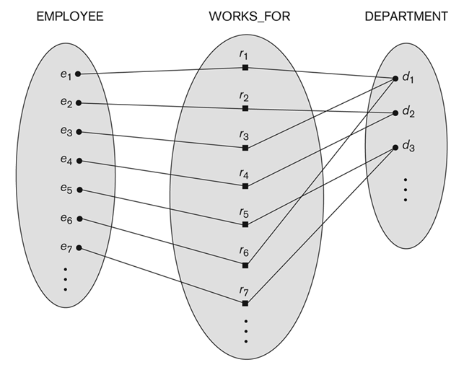
Many-to-one (N:1) Relationship
ER Modeling
Chapter 04-1 / 30

Slide 31
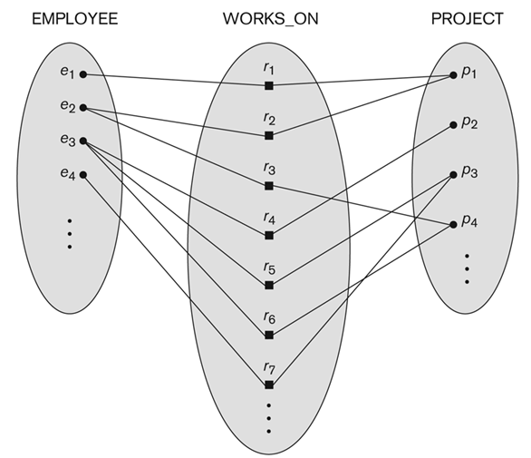
Many-to-many (M:N) Relationship
ER Modeling
Chapter 04-1 / 31

Slide 32
Displaying a recursive relationship
In a recursive relationship type.
Both participations are same entity type in different roles.
For example, SUPERVISION relationships between EMPLOYEE (in role of supervisor or boss) and (another) EMPLOYEE (in role of subordinate or worker).
In following figure, first role participation labeled with 1 and second role participation labeled with 2.
In ER diagram, need to display role names to distinguish participations.
ER Modeling
Chapter 04-1 / 32

Slide 33
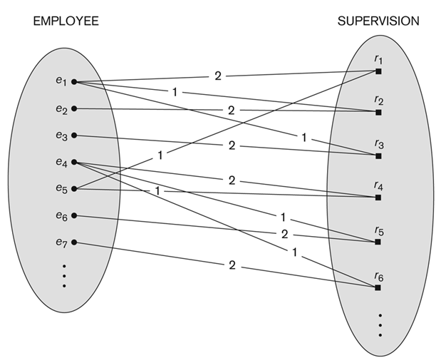
A Recursive Relationship Supervision
ER Modeling
Chapter 04-1 / 33

Slide 34
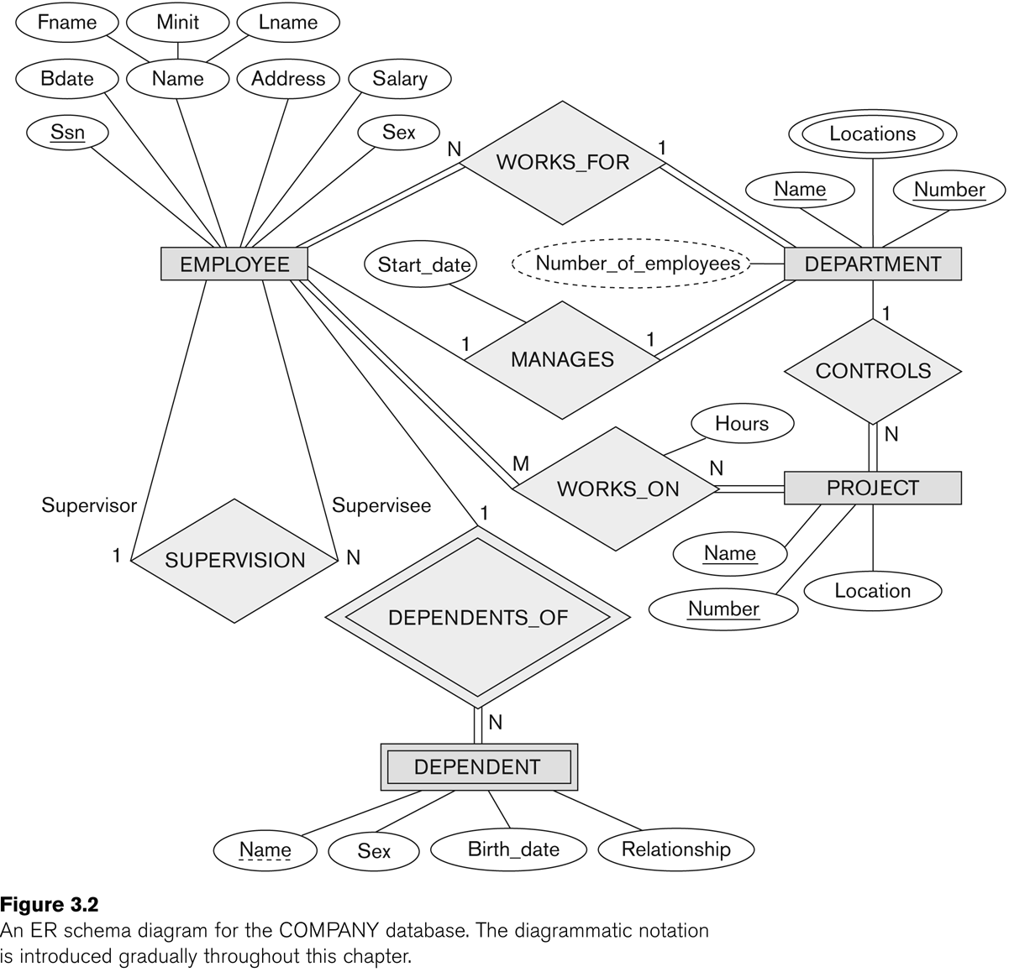
Recursive Relationship Type is: SUPERVISION (participation role names are shown)
ER Modeling
Chapter 04-1 / 34

Slide 35
Attributes of Relationship types
A relationship type can have attributes:
For example, HoursPerWeek of WORKS_ON
Its value for each relationship instance describes the number of hours per week that an EMPLOYEE works on a PROJECT.
A value of HoursPerWeek depends on a particular (employee, project) combination
Most relationship attributes are used with M:N relationships
In 1:N relationships, they can be transferred to the entity type on the N-side of the relationship
ER Modeling
Chapter 04-1 / 35

Slide 36
Derived Attribute
A derived attribute is one whose value is dynamic and can be derived from instances of a relationship or other attribute . It is represented by dashed oval in an ER Diagram. For example:
In an entity DEPARTMENT, we need an attribute “Number_of_employees” where its value is dynamic and can be derived from the instances of the WORKS_FOR relationship type
Another example, if in an entity STUDENT has two attributes called as date_of_birth and age, we can derive value of age with the help of date_of_birth attribute value
ER Modeling
Chapter 04-1 / 36

Slide 37
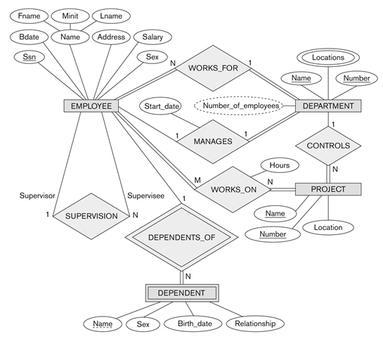
Example Attribute of a Relationship Type: Hours of WORKS_ON
ER Modeling
Chapter 04-1 / 37

Slide 38
Notation for Constraints on Relationships
Cardinality ratio (of a binary relationship): 1:1, 1:N, N:1, or M:N
Shown by placing appropriate numbers on the relationship edges.
Participation constraint (on each participating entity type): total (called existence dependency) or partial.
Total shown by double line, partial by single line.
NOTE: These are easy to specify for Binary Relationship Types.
ER Modeling
Chapter 04-1 / 38

Slide 39
Alternative (min, max) notation for relationship structural constraints:
Specified on each participation of an entity type E in a relationship type R
Specifies that each entity e in E participates in at least min and at most max relationship instances in R
Default(no constraint): min=0, max=n (signifying no limit)
Must have min≤max, min≥0, max ≥1
Derived from the knowledge of mini-world constraints
Examples:
A department has exactly one manager and an employee can manage at most one department.
Specify (0,1) for participation of EMPLOYEE in MANAGES
Specify (1,1) for participation of DEPARTMENT in MANAGES
An employee can work for exactly one department but a department can have any number of employees.
Specify (1,1) for participation of EMPLOYEE in WORKS_FOR
Specify (1,n) for participation of DEPARTMENT in WORKS_FOR
ER Modeling
Chapter 04-1 / 39

Slide 40
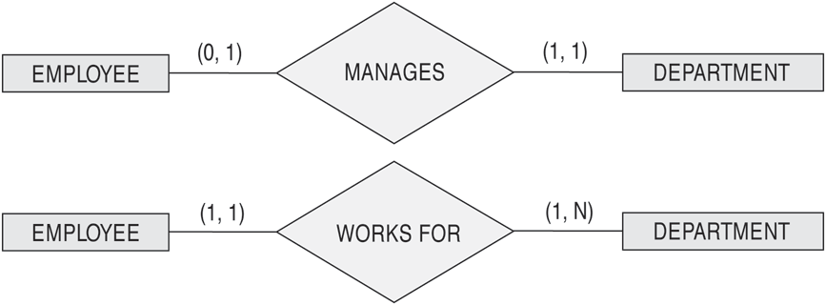
The (min,max) notation for relationship constraints
Read the min,max numbers next to the entity type and looking away from the entity type
ER Modeling
Chapter 04-1 / 40

Slide 41
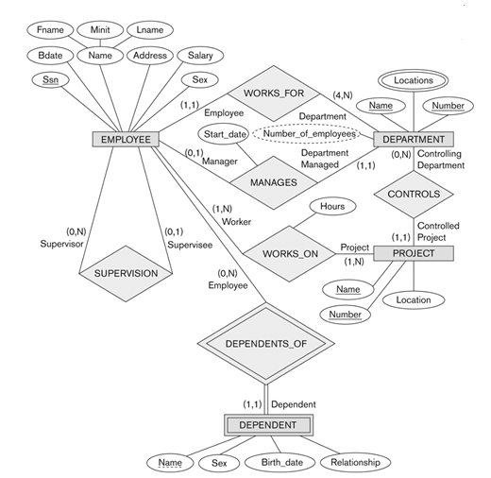
COMPANY ER Schema Diagram using (min, max) notation
ER Modeling
Chapter 04-1 / 41

Slide 42
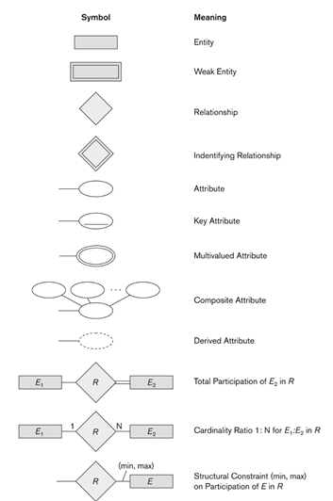
Summary of notation for ER diagrams
ER Modeling
Chapter 04-1 / 42

Slide 43
Alternative diagrammatic notation
ER diagrams is one popular example for displaying database schemas
Many other notations exist in the literature and in various database design and modeling tools
Appendix A illustrates some of the alternative notations that have been used
UML class diagrams is representative of another way of displaying ER concepts that is used in several commercial design tools
ER Modeling
Chapter 04-1 / 43

Slide 44
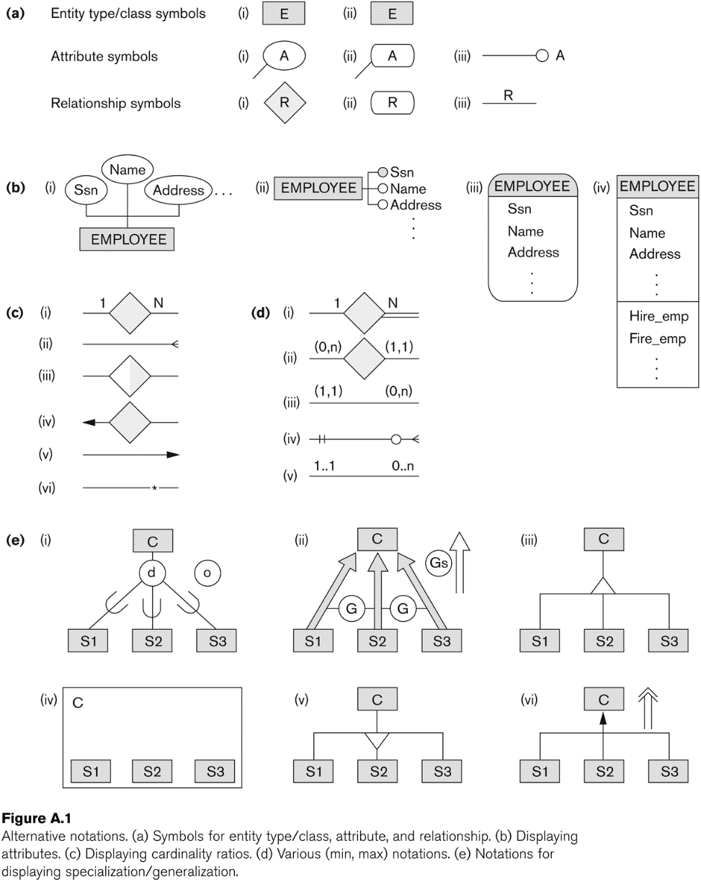
Other Alternative Diagrammatic Notations
ER Modeling
Chapter 04-1 / 44

Slide 45
Relationships of Higher Degree
Relationship types of degree 2 are called binary
Relationship types of degree 3 are called ternary and of degree n are called n-ary
In general, an n-ary relationship is not equivalent to n binary relationships
Constraints are harder to specify for higher-degree relationships (n > 2) than for binary relationships
ER Modeling
Chapter 04-1 / 45

Slide 46
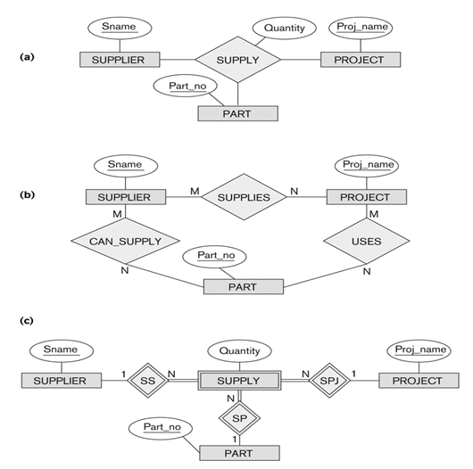
Discussion of n-ary relationships (n > 2)
In general, 3 binary relationships can represent different information than a single ternary relationship (see Figure a and b)
If needed, the binary and n-ary relationships can all be included in the schema design (see Figure a and b, where all relationships convey different meanings)
In some cases, a ternary relationship can be represented as a weak entity if the data model allows a weak entity type to have multiple identifying relationships (and hence multiple owner entity types) (see Figure c)
ER Modeling
Chapter 04-1 / 46

Slide 47
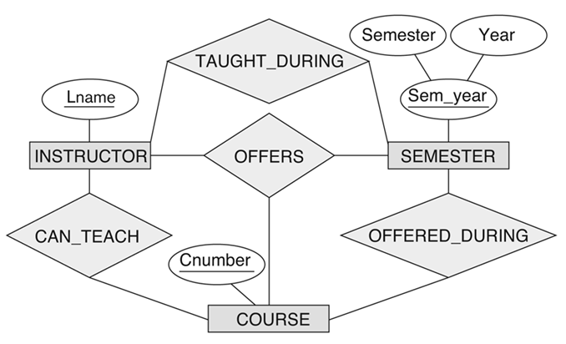
Discussion of n-ary relationships (n > 2)
If a particular binary relationship can be derived from a higher-degree relationship at all times, then it is redundant
For example, the TAUGHT_DURING binary relationship in Figure above can be derived from the ternary relationship OFFERS (based on the meaning of the relationships)
ER Modeling
Chapter 04-1 / 47

Slide 48
Displaying constraints on higher-degree relationships
The (min, max) constraints can be displayed on the edges – however, they do not fully describe the constraints
Displaying a 1, M, or N indicates additional constraints
An M or N indicates no constraint
A 1 indicates that an entity can participate in at most one relationship instance that has a particular combination of the other participating entities
In general, both (min, max) and 1, M, or N are needed to fully describe the constraints
ER Modeling
Chapter 04-1 / 48

Slide 49
Data Modeling Tools
A number of popular tools that cover conceptual modeling and mapping into relational schema design.
Examples: ERWin, S- Designer (Enterprise Application Suite), ER- Studio, etc.
POSITIVES:
Serves as documentation of application requirements, easy user interface - mostly graphics editor support
NEGATIVES:
Most tools lack a proper distinct notation for relationships with relationship attributes
Mostly represent a relational design in a diagrammatic form rather than a conceptual ER-based design
ER Modeling
Chapter 04-1 / 49

Slide 50
Some of the Currently Available Automated Database Design Tools
COMPANY | TOOL | FUNCTIONALITY
Embarcadero Technologies | ER Studio | Database Modeling in ER and IDEF1X
 | DB Artisan | Database administration, space and security management
Oracle | Developer 2000/Designer 2000 | Database modeling, application development
Popkin Software | System Architect 2001 | Data modeling, object modeling, process modeling, structured analysis/design
Platinum (Computer Associates) | Enterprise Modeling Suite: Erwin, BPWin, Paradigm Plus | Data, process, and business component modeling
Persistence Inc. | Pwertier | Mapping from O-O to relational model
Rational (IBM) | Rational Rose | UML Modeling & application generation in C++/JAVA
Resolution Ltd. | Xcase | Conceptual modeling up to code maintenance
Sybase | Enterprise Application Suite | Data modeling, business logic modeling
Visio | Visio Enterprise | Data modeling, design/reengineering Visual Basic/C++
ER Modeling
Chapter 04-1 / 50

Slide 51
In-Class Exercise(1)
A function F1 for which no nurse is certified for that particular function, served by several wards (Yes/No?)
A nurse certified for functions F1 and F2 works for a ward that serves no function at all (Yes/No?)
A Nurse certified for a function F1 works for a ward that serves both functions F3 and F4 only (Yes/No?)
A nurse who has no certification works for a ward B1 (Yes/No?)
A nurse with NID N1 certified for functions F1 and F2 only, but no ward serves those two functions (Yes/No?)
ER Modeling
Chapter 04-1 / 51

Slide 52
In-Class Exercise (2)
Using our ER notation, draw an ER diagram for the small case below that is concerned with a database requirement for a very small manufacture company.
The database contains information regarding employee, factory, and product
Each employee identified by a unique identification number, name, an monthly salary
A factory identified by a unique identification number, name, budget
ER Modeling
Chapter 04-1 / 52

Slide 53
In-Class Exercise (2) – Cont’d
Each product is also identified by a unique product ID and its associated product name
Each subordinate employee must report his activity to at most an employee who becomes his/her direct supervisor
Each employee may work on at least one factory
Each product is fabricated in exactly in one factory
Each product can be a component of several other products
ER Modeling
Chapter 04-1 / 53

Slide 54
In-Class Exercise (3)
Consider the ER diagram below, which shows a simplified schema for an airline reservations system. Extract from the ER diagram the requirements and constraints that produced this schema. Try to be as precise as possible in your requirements and constraints specification
ER Modeling
Chapter 04-1 / 54

Slide 55
In-Class Exercise (3) – Cont’d
ER Modeling
Chapter 04-1 / 55

Slide 56

End of Chapter 04-1

